Slide 1

Application of weight-based target selective anthelmintic treatment (TST) strategy on hill and upland sheep flocks
Fiona Kenyon¹, Claire Morgan-Davies², Nicola Lambe², Harriet Wishart², Anthony Waterhouse², David McBean¹, Davy McCracken².
¹Moredun Research Institute, Edinburgh
²Scotland’s Rural College, Hill and Mountain Research Centre, Kirkton and Auchtertyre, Crainlarich, Perthshire.
Notes:
Good afternoon, today I’d like to present some findings from recent studies we carried out on three farms in Scotland and Northern England where we’ve been looking at ways to improve the uptake of TST by sheep farmers.
There are a number of approaches to slowing anthelmintic resistance, and we have been concentrating on TST using the Happy Factor weight prediction method developed at Moredun.

Slide 2
Happy FactorTM TST
Targeted selective treatment: treatment of individual animals. Reduce production-limiting effects of roundworm infection
Short-term weight based “Happy factor” approach (Greer et al, 2009) – predict weigh gain, animals treated if fail to reach target
Been tested in field experiments, on range of commercial farms and with different breeds
Aim – test approach on hill/upland flocks
Greer et al, 2009, Vet. Para, 164: 12-20; Kenyon et al, 2013, IJP:DDR, 3:77-84; Busin et al, 2014, Vet. J. 200: 248-252; McBean et al, 2016, Vet. Para. 229:1-8
Notes:
Happy Factor TST is a production based method which uses a mathematical model to generate weight targets for individual lambs.
We’ve previously shown on our research farm that it can slow the development of resistance by reducing anthelmintic use, without meaningful reduction in productivity.
We also used the same method on several commercial and other research farms with similar success at reducing anthelmintic input with no production losses.
To determine whether an animal requires treatment, the Happy Factor method calculates a cutoff weight threshold of 0.66 of theoretical maximum growth given the previous bodysize, climate and food availability.
The 0.66 cutoff value for treatment was determined following analysis of the response to treatment at the original site, but farms and sheep differ in their productivity, so we felt we needed some information about whether this cutoff value should be specific to each farm, notwithstanding the difficulty this could add to persuading farmers to use this method of treating for nematode infection

Slide 3
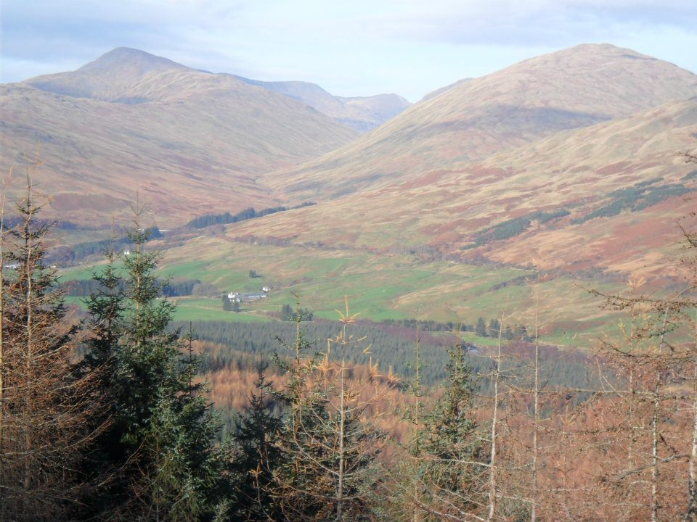
Study Site/Plan
Three year study (2013 – 2015) conducted at SRUC’s Kirkton and Auchtertyre farms.
Notes:
This just gives a general overview of the consequence of using a threshold that’s not correct for that farm.
Too high a threshold (Moving to the right on this schematic) means we will be treating more lambs and are more likely to be administering treatments that have little or no effect on productivity, and simply serve to increase the number of drug exposed parasites being excreted onto pasture.
Conversely, if the threshold is too low, we treat fewer lambs and run the risk of missing treatments which would have benefitted the farm by maintaining lamb production.
So we should be aiming to hit the sweet spot in the middle, where as many lambs as possible are left untreated, but we still target the poor performers.

Slide 4
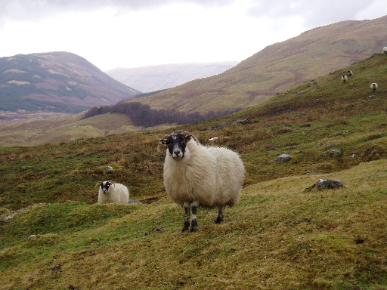
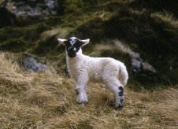
Groups
902 ewes (Blackface and Lleyn) split between two management approaches but co-grazing:
  CON – conventionally managed
    wormed only if pooled FEC of all groups (singles/twins separate) >500 epg
  PLF – precision livestock farming approach
    TST applied, only lambs failing to meet weight target treated
Notes:
We aimed to calculate the optimum cut off values for treatment at four sites;
Two were research farms, including that where the original cutoff data was generated, where we wanted to look at how consistent the cutoff is over time.
The other research farm is a mixed upland and hill farm, where we trialled TST in an extensive grazing system.
We also used data from two commercial sites, one lowland and one upland, which also formed part of our TST studies.
To avoid the biased nature of TST treatments we only used data from planned treatment control groups for this analysis. We calculated the efficiency of animals before and after treatments and used ROC curve analysis to generate the optimum threshold for each far.
From this we were able to retrospectively calculate the number of treatments which would have been given under TST using both the original (Standard) cutoff of 0.66 and the farm specific cutoff value.
We also estimated the production effects of using these threshold values by using pre and post-treatment growth rates.

Slide 5
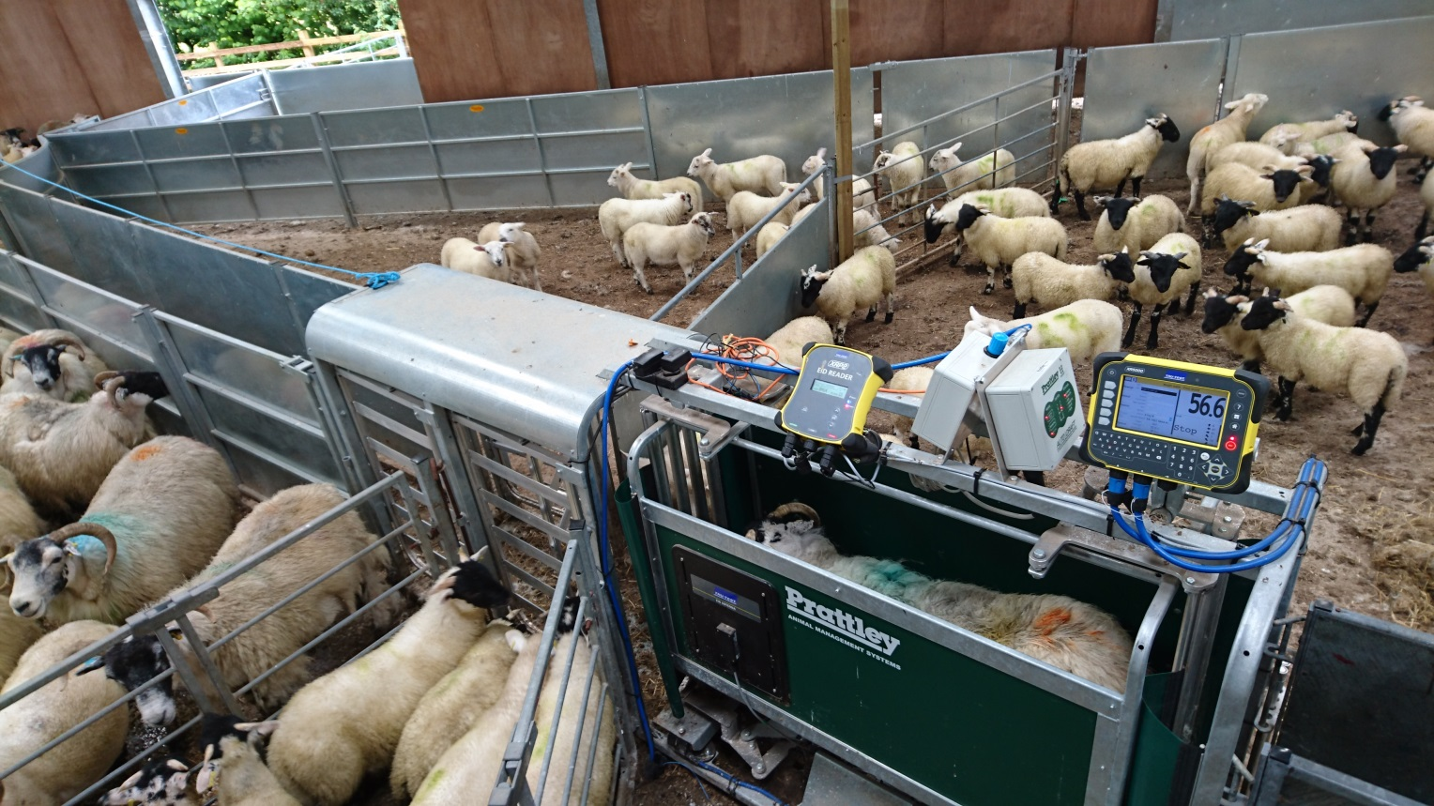
Lambs EID tagged, Treatment decisions June – September, dosed to heaviest lamb in group
Labour (hours) measured using videos/direct observations, cost £11/hour.

Slide 6
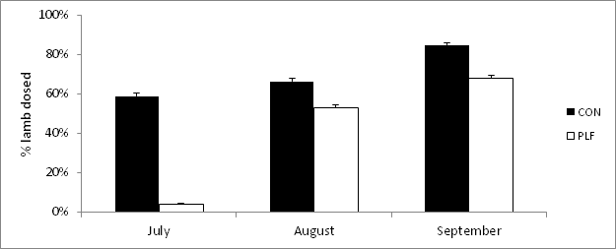
Wormer treatments
* Error bars represent standard deviation
PLF lambs needed 40% less wormer than CON lambs (χ² test, P<0.001) .
Notes:
Here are the Estimated treatment thresholds generated by the ROC analysis.
Farm 1 is the original site, and somewhat surprisingly, the Estimated threshold here is higher than the Standard value.
In fact, all of the farms with the exception of farm 3 (which is the other research farm, and uses two breeds grazing on upland and hill pastures) has a higher Estimated threshold than the Standard value.
So what effect would there be if we used these thresholds rather than the standard 0.66?

Slide 7
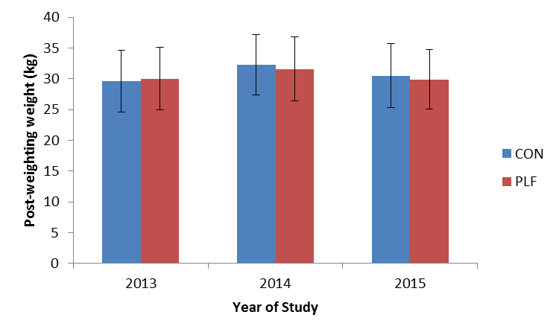
Effects on lamb weight
* Error bars represent the standard deviation
No significant difference between post-weaning weights (P=0.072)
Notes:
To get an estimate of the production difference between the two cutoff values, we assumed that growth rate would remain constant without anthelmintic input.
So animals which would not have been treated were assigned their pre-treatment growth rate, and those treated assigned their actual post-treatment growth rates.
None of the farms showed any effect of changing from the Standard cutoff value to the farm specific one, and this likely reflects the small gains to be made by treating animals with parasite infections which are only causing marginally production limiting pathology

Slide 8
Labour costs
Year | System | Worming costs (£) | Labour (hrs) | Labour Costs (£) | Total Costs (£)
2013 | CON | 63 | 16.0 | 137 | 200
 | PLF | 13 | 3.1 | 27 | 40
2014 | CON | 79 | 16.5 | 147 | 221
 | PLF | 13 | 3.0 | 26 | 39
2015 | CON | 70 | 16.7 | 144 | 214
 | PLF | 13.5 | 3.8 | 33 | 46
Average cost CON £211.67 vs PLF £41.66,
labour costs reduced by ~£1.60/lamb
Notes:
This shows us the number of treatments we would have given,
Since the data we used here was from individual animal treatments the actual figure without TST was 1 treatment per animal, so each farm would have treated less at either threshold.
The farms where the threshold was higher would all have treated significantly more animals compared with standard threshold TST(P<0.05, ANOVA of treat = 1, no treat = 0), the only exception being Farm 3, where the threshold was slightly lower and thus slightly fewer treatments were predicted.
The key question we can take from this however, is would these increased treatments have had any effect on productivity?
These extra treatments would be given to animals with efficiencies close to the point where treatment becomes effective, and so are likely to be of marginal value in terms of production gains.

Slide 9
Conclusions
The PLF approach, with implementation of TST resulted in:
  Reduction in wormer used (40% reduction)
  No significant difference in weight
  Savings of approx. £1.60 per lamb in labour costs
TST therefore, is applicable to upland/hill flocks, and can integrate with gathering animals for other management needs.
Notes:
So to conclude:
We’ve shown previosuly that Happy Factor TST is capable of reducing anthelmintic input without production losses…
But here we wanted to see if it was enough to use the same criteria on every farm.
At first it would appear from theses results that the threshold is technically different on the farms we examined here, and that that corresponds to apparently higher need for anthelmintic.
But when we looked into the implications for productivity, the estimates of growth rates did not change with those extra treatments, indicating they would be of little benefit, and that there is a degree of elasticity in the threshold, sufficient that we can suggest a single treatment threshold for all farms.

Slide 10

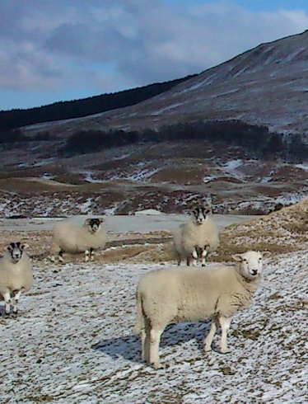
Acknowledgements
Staff at the SRUC’s Hill & Mountain Research Centre
Funding received from:
RESAS, Strategic Research Programmes (2011-16 and 2016-21)

