Slide 1
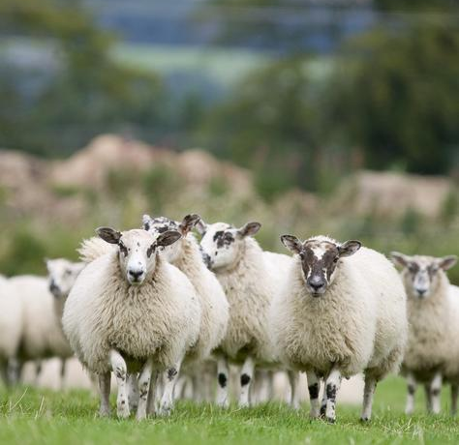
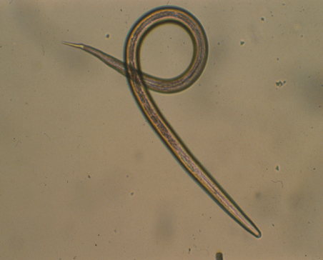

Weight-based targeted selective treatment (TST) on Scottish hill and upland sheep flocks
Fiona Kenyon
Moredun Research Institute, Edinburgh
Scotland’s Rural College, Hill and Mountain Research Centre,
Kirkton and Auchtertyre
Notes:
Good afternoon, today I’d like to present some findings from recent studies we carried out on three farms in Scotland and Northern England where we’ve been looking at ways to improve the uptake of TST by sheep farmers.
There are a number of approaches to slowing anthelmintic resistance, and we have been concentrating on TST using the Happy Factor weight prediction method developed at Moredun.

Slide 2
Happy FactorTM TST
Targeted selective treatment: treatment of individual animals. Reduce production-limiting effects of roundworm infection
Short-term weight based “Happy factor” approach (Greer et al, 2009) – predict weigh gain, animals treated if fail to reach target
Been tested in field experiments, on range of commercial farms and with different breeds
Aim – test approach on hill/upland flocks
Greer et al, 2009, Vet. Para, 164: 12-20; Kenyon et al, 2013, IJP:DDR, 3:77-84; Busin et al, 2014, Vet. J. 200: 248-252; McBean et al, 2016, Vet. Para. 229:1-8

Slide 3
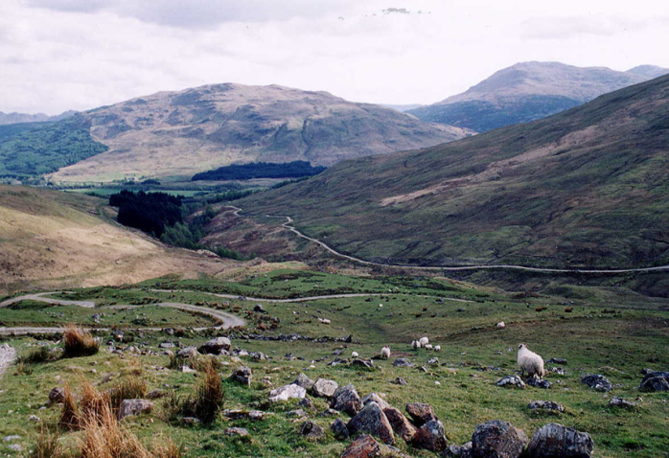
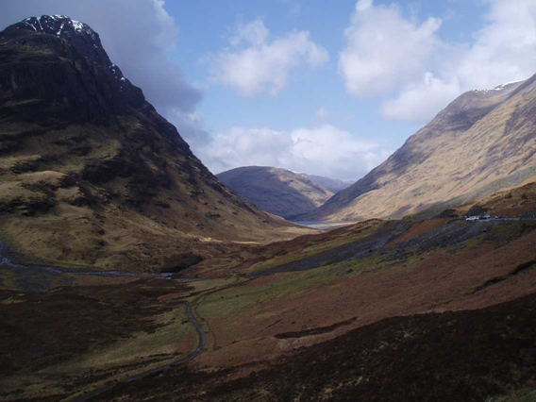
Scottish Hill farming
Challenging
  Marginal land/poor land
  Large size flocks (>1000),
  low stocking density
  Labour critical
  Economically fragile, reliance on support

Slide 4
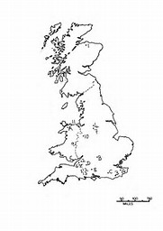
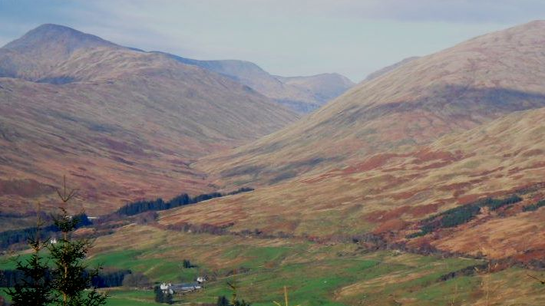
SRUC Hill & Mountain Research Centre
  Research hill farm
  In marginal areas of Scotland
  1300 sheep2200 ha – mostly hill land

Slide 5
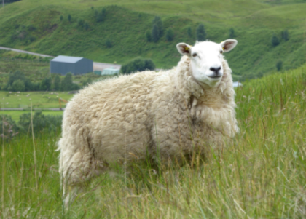
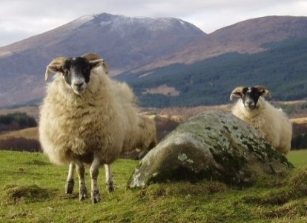
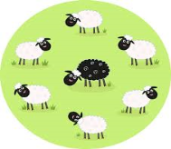


Study plan
2 management systems,
2013-2015, ~900 ewes
Conventional
Non-EID managed
Precision Livestock Farming
EID managed
Use manual sorting
Use EID technology
Based on BCS
+ scan result (>Feb)
Based on % weight change
+ scan result (>Feb)
Whole flock approach
- pooled FEC, threshold
Targeted Worming
- lamb weight change
Notes:
Say one of the flock is 900 animals – this is the one being presented here.
2 management systems – all animals are together except at key handling times.
2 handling management : describe
Then describe the 2 key times when management of animals is different
Say record labour at every task.

Slide 6

Data recording
Ewe winter feeding
Mating (Nov)
Mid-pregnancy scanning (Feb)
Pre-lambing (March)
Lambing
(April)
8 weeks after lambing
Shearing (July)
Weaning (Aug)
Sales (Sept/Oct)
Post mating (Jan)
Lamb worming
Notes:
Go through the circle – to explain how the sheep year works in Scotland in extensive systems.
Then say that animals are all handled at these times but one with classic weigh crate, the other with EID sorter - + specific different management at these 4 times. (but not talk about it in the presentation)

Slide 7
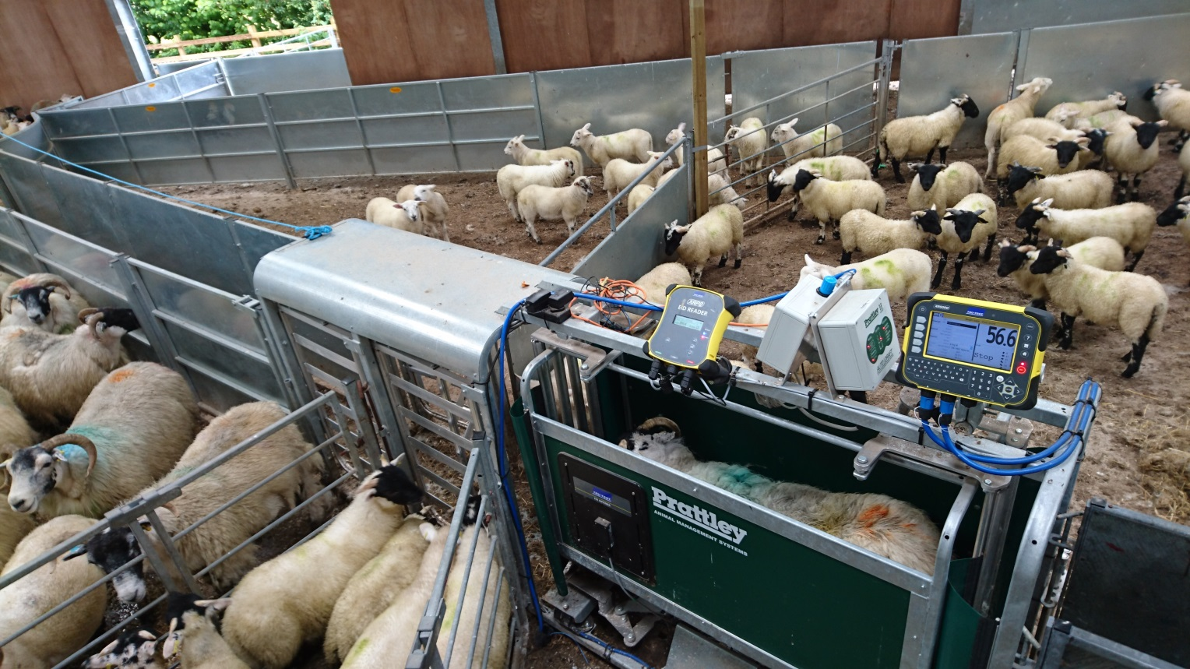

Slide 8
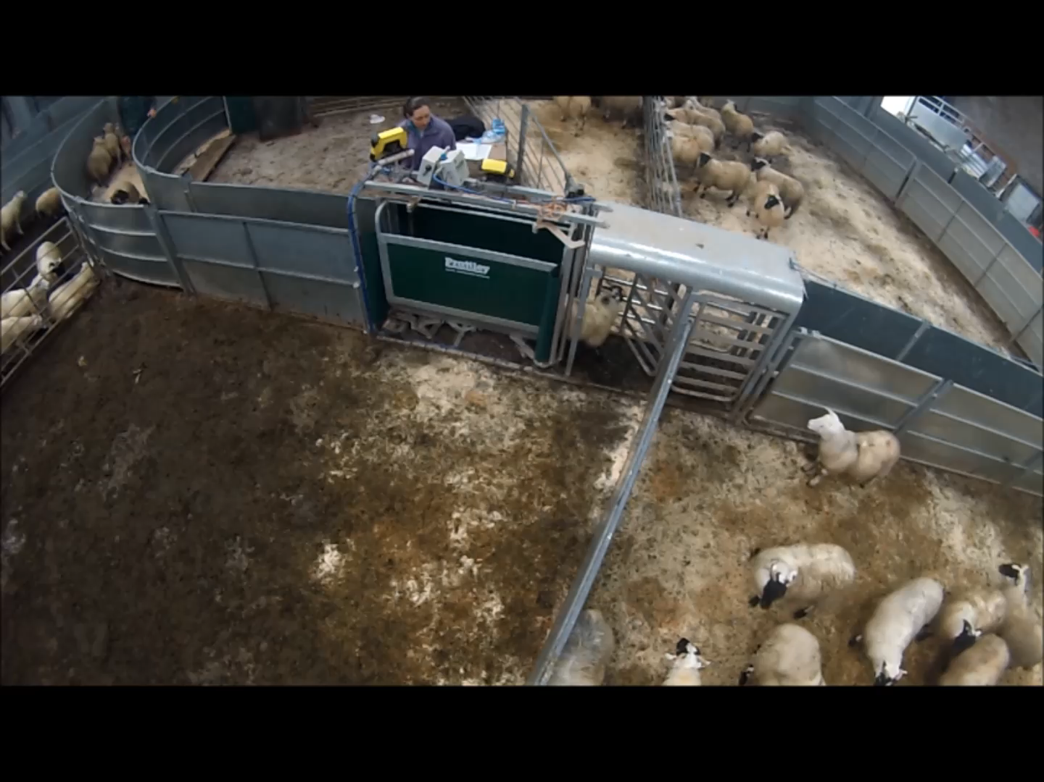
Lambs EID tagged, Treatment decisions monthly July – September
Labour (hours) measured using videos/direct observations at cost £11 per hour
€11.90/US$14/MYR60.70 per hour

Slide 9
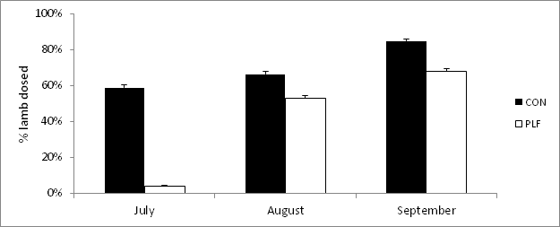
Wormer treatments
* Error bars represent standard deviation
PLF lambs needed 40% less wormer than CON lambs (χ² test, P<0.001) .
Notes:
Here are the Estimated treatment thresholds generated by the ROC analysis.
Farm 1 is the original site, and somewhat surprisingly, the Estimated threshold here is higher than the Standard value.
In fact, all of the farms with the exception of farm 3 (which is the other research farm, and uses two breeds grazing on upland and hill pastures) has a higher Estimated threshold than the Standard value.
So what effect would there be if we used these thresholds rather than the standard 0.66?

Slide 10
Effect on lamb weight
Mean weight 2013-2015

Slide 11
Annual labour profile

Slide 12
Results – annual labour (8 hours day)
 | CON | PLF
Overall | 42 days | 25 days
Winter feeding | 4 days | 3 days
Worming lambs | 13 days | 9 days
Notes:
If we want to scale up to typical extensive systems in Scotland, where the average flock size is around 1200 ewes with 1000 lambs, this is what we get in terms of labour savings.

Slide 13
Mean Worming Costs
System | Worming costs (£) | Labour (hrs) | Labour Costs (£) | Total Costs (£)
CON | 70.67 | 16.4 | 142.67 | 213.34
PLF | 13.17 | 3.3 | 28.67 | 41.84
Worming costs reduced by ~£1.60/lamb
€1.70/US$2/MYR8.80
Notes:
This shows us the number of treatments we would have given,
Since the data we used here was from individual animal treatments the actual figure without TST was 1 treatment per animal, so each farm would have treated less at either threshold.
The farms where the threshold was higher would all have treated significantly more animals compared with standard threshold TST(P<0.05, ANOVA of treat = 1, no treat = 0), the only exception being Farm 3, where the threshold was slightly lower and thus slightly fewer treatments were predicted.
The key question we can take from this however, is would these increased treatments have had any effect on productivity?
These extra treatments would be given to animals with efficiencies close to the point where treatment becomes effective, and so are likely to be of marginal value in terms of production gains.

Slide 14
Conclusions
The PLF approach, with implementation of individual lamb worming (TST) resulted in:
  Reduction in wormer used (40% reduction)
  No significant difference in weight
  Savings of approx. £1.60 per lamb in labour costs
TST applicable to upland/hill flocks and can integrate with other management needs to deliver sustainable worm control.
Notes:
So to conclude:
We’ve shown previosuly that Happy Factor TST is capable of reducing anthelmintic input without production losses…
But here we wanted to see if it was enough to use the same criteria on every farm.
At first it would appear from theses results that the threshold is technically different on the farms we examined here, and that that corresponds to apparently higher need for anthelmintic.
But when we looked into the implications for productivity, the estimates of growth rates did not change with those extra treatments, indicating they would be of little benefit, and that there is a degree of elasticity in the threshold, sufficient that we can suggest a single treatment threshold for all farms.

Slide 15

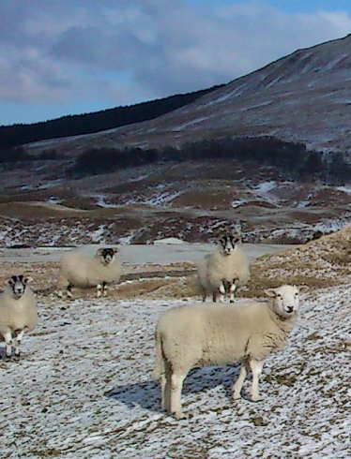
Acknowledgements
Moredun Research Institute:
Dave McBean
SRUC’s Hill & Mountain Research Centre:
Claire Morgan-Davies
Nicola Lambe
Harriet Wishart
Anthony Waterhouse
Davy McCracken
Funding received from:
RESAS, Strategic Research Programmes (2011-16 and 2016-21)

