Slide 1




Supporting Agriculture and Rural
Development Policy
David Miller*
Keith Matthews*, Steven Thomson**
Andrew Moxey***, Dave Miller*
*James Hutton Institute, **Scotland’s Rural College, ***Pareto Consulting
RESAS Science, Evidence and Policy Conference, 18 May 2023, Dynamic Earth, Edinburgh

Slide 2


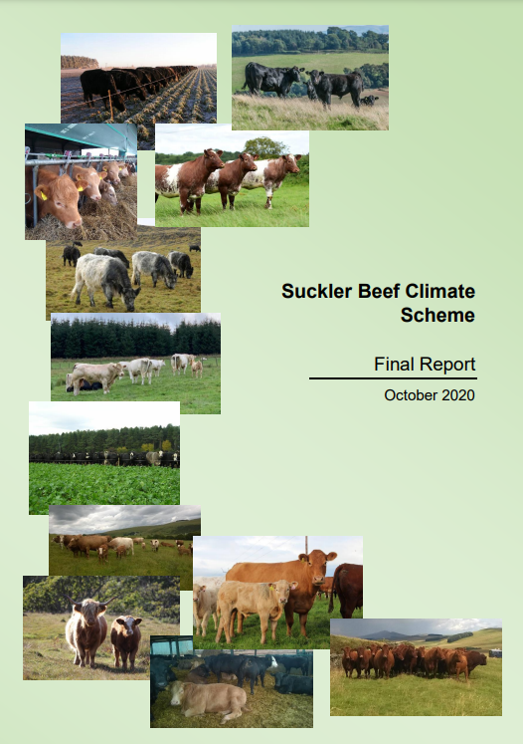
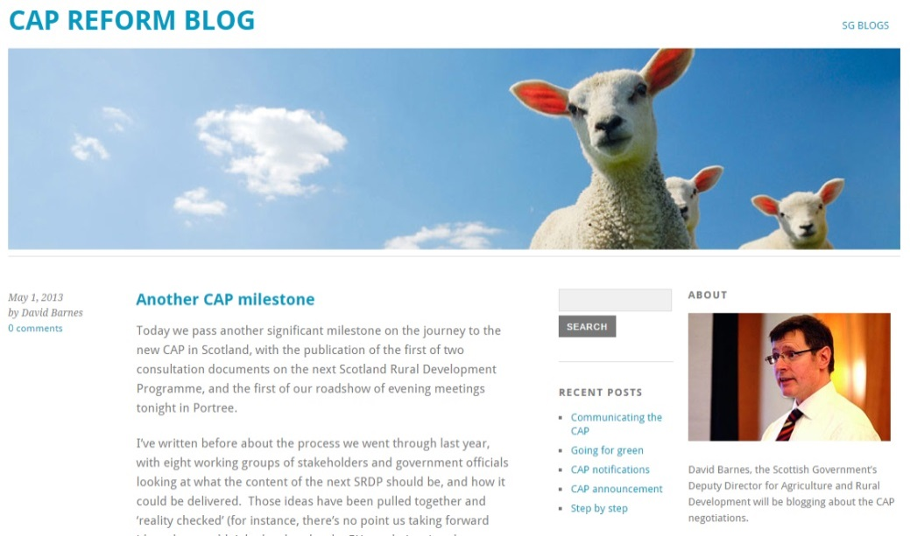

Policy Contexts and Research Partnership
Agriculture and rural development
  Example policy contexts
      CAP Pillar 1 Analysis
      Areas of Natural Constraint
      Greening Review
      New payments systems (e.g. enhanced conditionality)
  Partnerships: Example Science / policy forums
  Agriculture Reform Implementation Oversight Board
  Agriculture and Rural Development Stakeholders Group
  Farmer Led Groups
  Partnerships: Science / policy funding and advice
  Strategic Research Programmes 2011-16, 2016-22, 2022-27
  Underpinning National Capacity, policy call-down
  Scottish Government Science Advice Unit

Slide 3





Purpose and Nature of Engagement
To inform deliberations within Scottish Government, and between Scottish Government and stakeholders on future agriculture policy
A process for defining, undertaking and interpreting research with policy
  Quantitative Story Telling (QST)
  5-stages - Cycles of analysis
    Co-construction
    Co-interpretation
Identify key themes relevant to land use policy
Decide what to represent in quantitative analysis
Compile data, carry out quantitative analysis
Contextualise and present metrics as maps and visualisations
Discuss interpretations and implications
A QST
Cycle
Work being further developed in Strategic Research Programme 2022-27, JHI-C3-1, SRUC C3-1

Slide 4
Observations on the Origins of Research
Disadvantage sub-group
Land Use
Topic C3
2024
2023
2022
ARIOB Advice
Payment
Regionalisation
Rural Industries
WP2.4
Agricultural Champions
ARD Stakeholders
2016
2017
2018
2019
2020
2021
ANC Options
Pillar 1 Reform Impacts
Grouse
Muirburn,
ANC, Capping
Woodland Carbon
Peatlands & Payments
ARD Stakeholders
Economic Adaptation
Theme 4
2015
2014
2013
2012
2011
Greening Review
Redistributive Payment option
Area-based Payments options
Eligible Areas & Stocking Rates
Land Capability Options
James Hutton Institute formed
Sustainable Farming Systems
Programme 3.1
2006
2007
2008
2009
2010
First SRP starts SAC + MLURI
Using IACS data for research
SAF-JAC
Area-based Payments Pilot
Pack Review

Slide 5
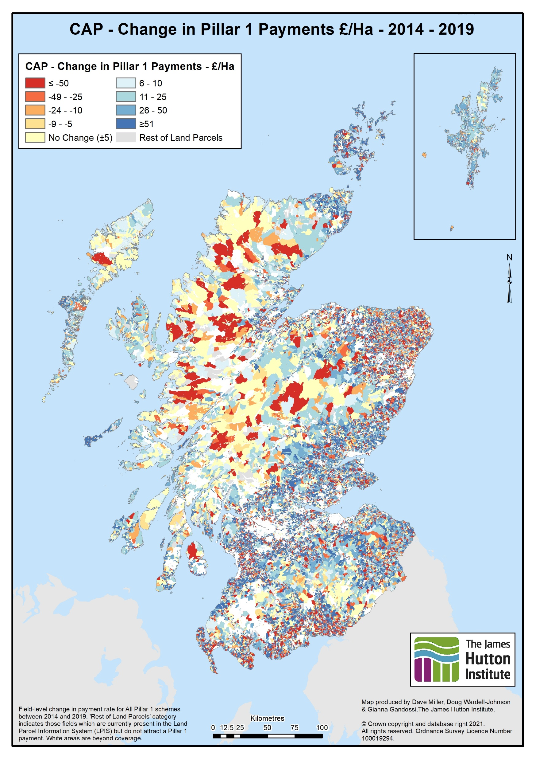
Types of Outputs
Proactive and reactive
Diagnostic – state of play
Counter-factual - what-if, options
Formats
  Presenting – participating in deliberation
  Reports, briefings, workshop handouts
  Working papers, Powerpoint
  Visualisations – relationships, flows
  Static maps, story maps, interactive maps
  Data for further analysis within Scottish Government (less often)
  Models, apps, tools (rarely)
Map: Matthews et al. (2021) 2014 vs 2019 Pillar 1 and 2 payments comparisons for ARD stakeholders. Online, December 2021. https://ics.hutton.ac.uk/research/land-systems-research-team/cap-analysis/cap-pillar-1-analysis/

Slide 6
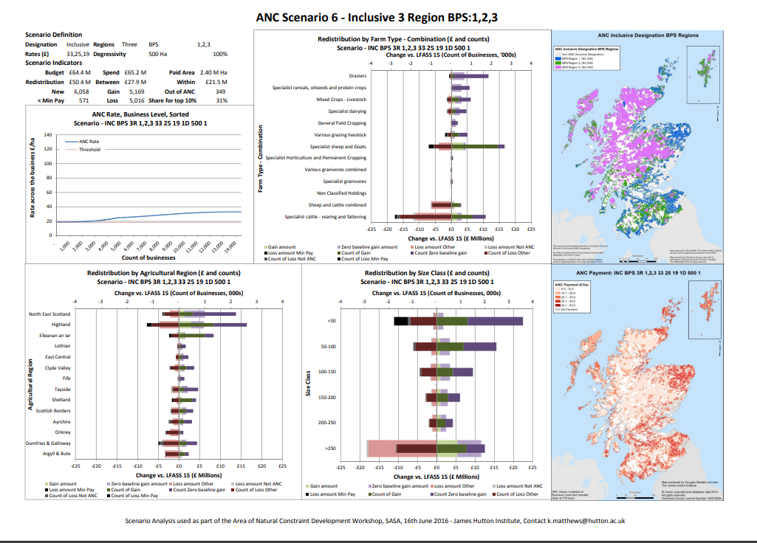
Areas of Natural Constraint
Example of scenario analysis (27 scenarios)
What might happen and where when multiple policy levers are pulled at once?

Slide 7
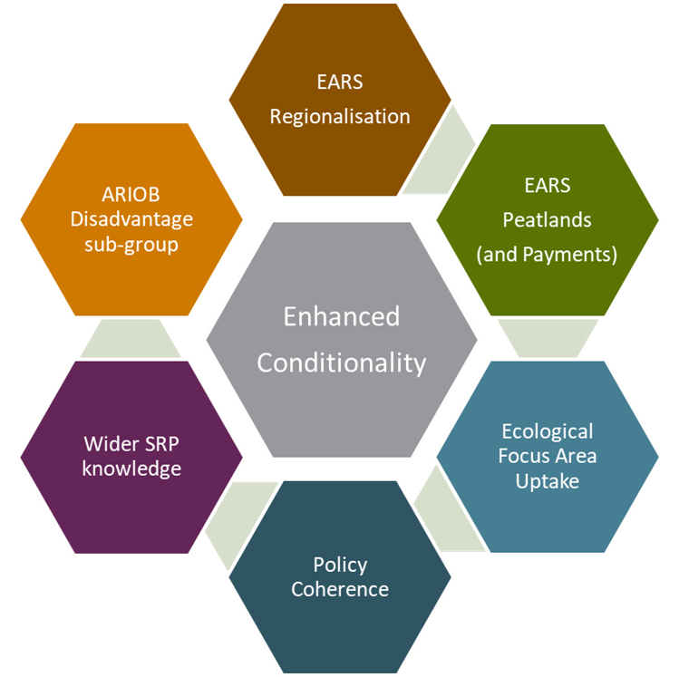
Layering and Leveraging Funding
Strategic Research Programme
  Resources – data, methods, tools, time
  Capability – knowledge, experience
  Capacity – policy relevant
    Anticipation
    Experimentation
  Credibility building
  Underpinning Capacity
  Policy-led: call-down – co-construction
  Salience shaping
  Network building – analysts, officials, stakeholders
  Knowledge elicitation
Contract / Responsive Research Funds
  Policy-led: project based
  Beyond Main Research Provider teams (Pareto)
Platform Funding
  Participation in UK and EU wide projects
  Alternative policy options

Slide 8

Thank you
sefari.scot
info@sefari.scot
@SEFARIscot

