Slide 1
Authenticity and provenance in Agri-food Supply chains
SFD Partnership Board meeting 21st February 2019

Slide 2
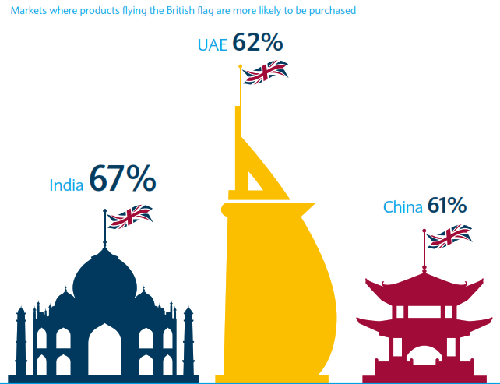
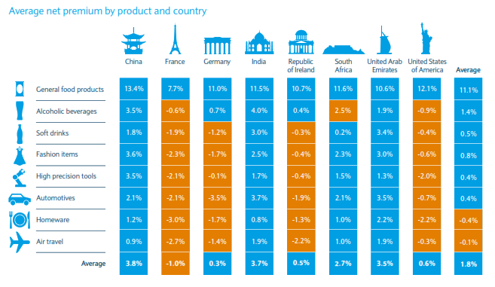
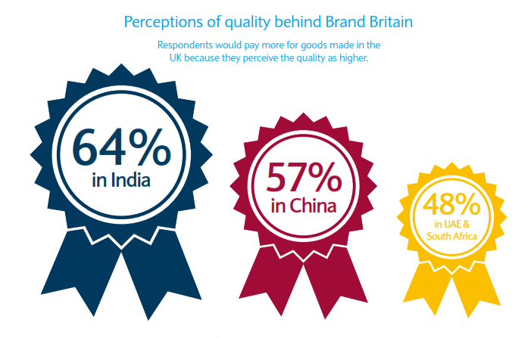
The Value of Brand Britain
Brand Britain: Export Opportunities for UK businesses

Slide 3
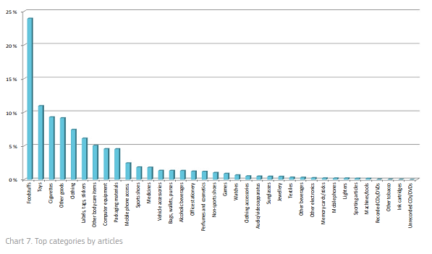
The Value of Brand Britain
Report on the EU Customs enforcement of Intellectual property rights: Results at the EU border, 2017
Food Fraud costs £1.17bn in the UK

Slide 4
Scope
Integrity
Quality
Fraud
Authenticity
Safety
Provenance
Traceability
Legislation
Notes:
Redraft this section

Slide 5
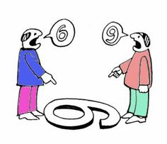
Glossary
Provenance
“Where did the product originate from?”
Authenticity
“Is the product what it say it is?”
Traceability
“Can we know where the product has been at all stages of the supply chain?”

Slide 6
Technologies

Slide 7
Technology
Spectroscopy
NMR
IR
UV-Vis
Fluorescence
Hyperspectral imaging
Chromatography
Ion-chromatography
HPLC
GC-FID
Mass spectrometry
GC-MS
DI-MS
LC-MS
ICP-MS
IR-MS
Electronic nose
PCR-based markers
SSRs
SNPs
RT-PCR
KASP assay
Targeted NGS
Isothermal PCR
RFID
NFC
Bar-codes
QR-codes
BCT
Centralised database systems
Multivariate analysis

Slide 8
Focus applications

Slide 9
Genetic markers

Slide 10
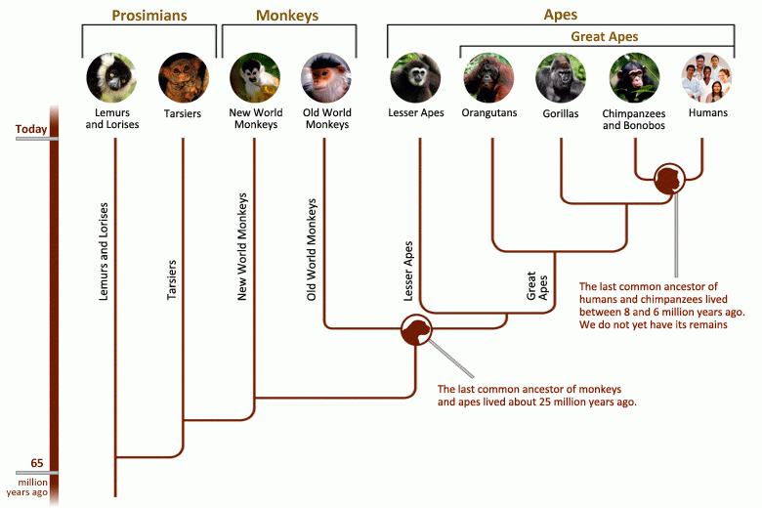
Genetic markers
1%
http://humanorigins.si.edu/evidence/genetics

Slide 11
Genetic markers
0.1%
Yann Arthus-Bertrand

Slide 12
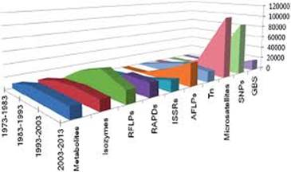
Genetic markers
High discrimination
WGS
TgtS
SNPs
SSR
RAPD
ISSR
Low discrimination
RFLP
£
£££

Slide 13
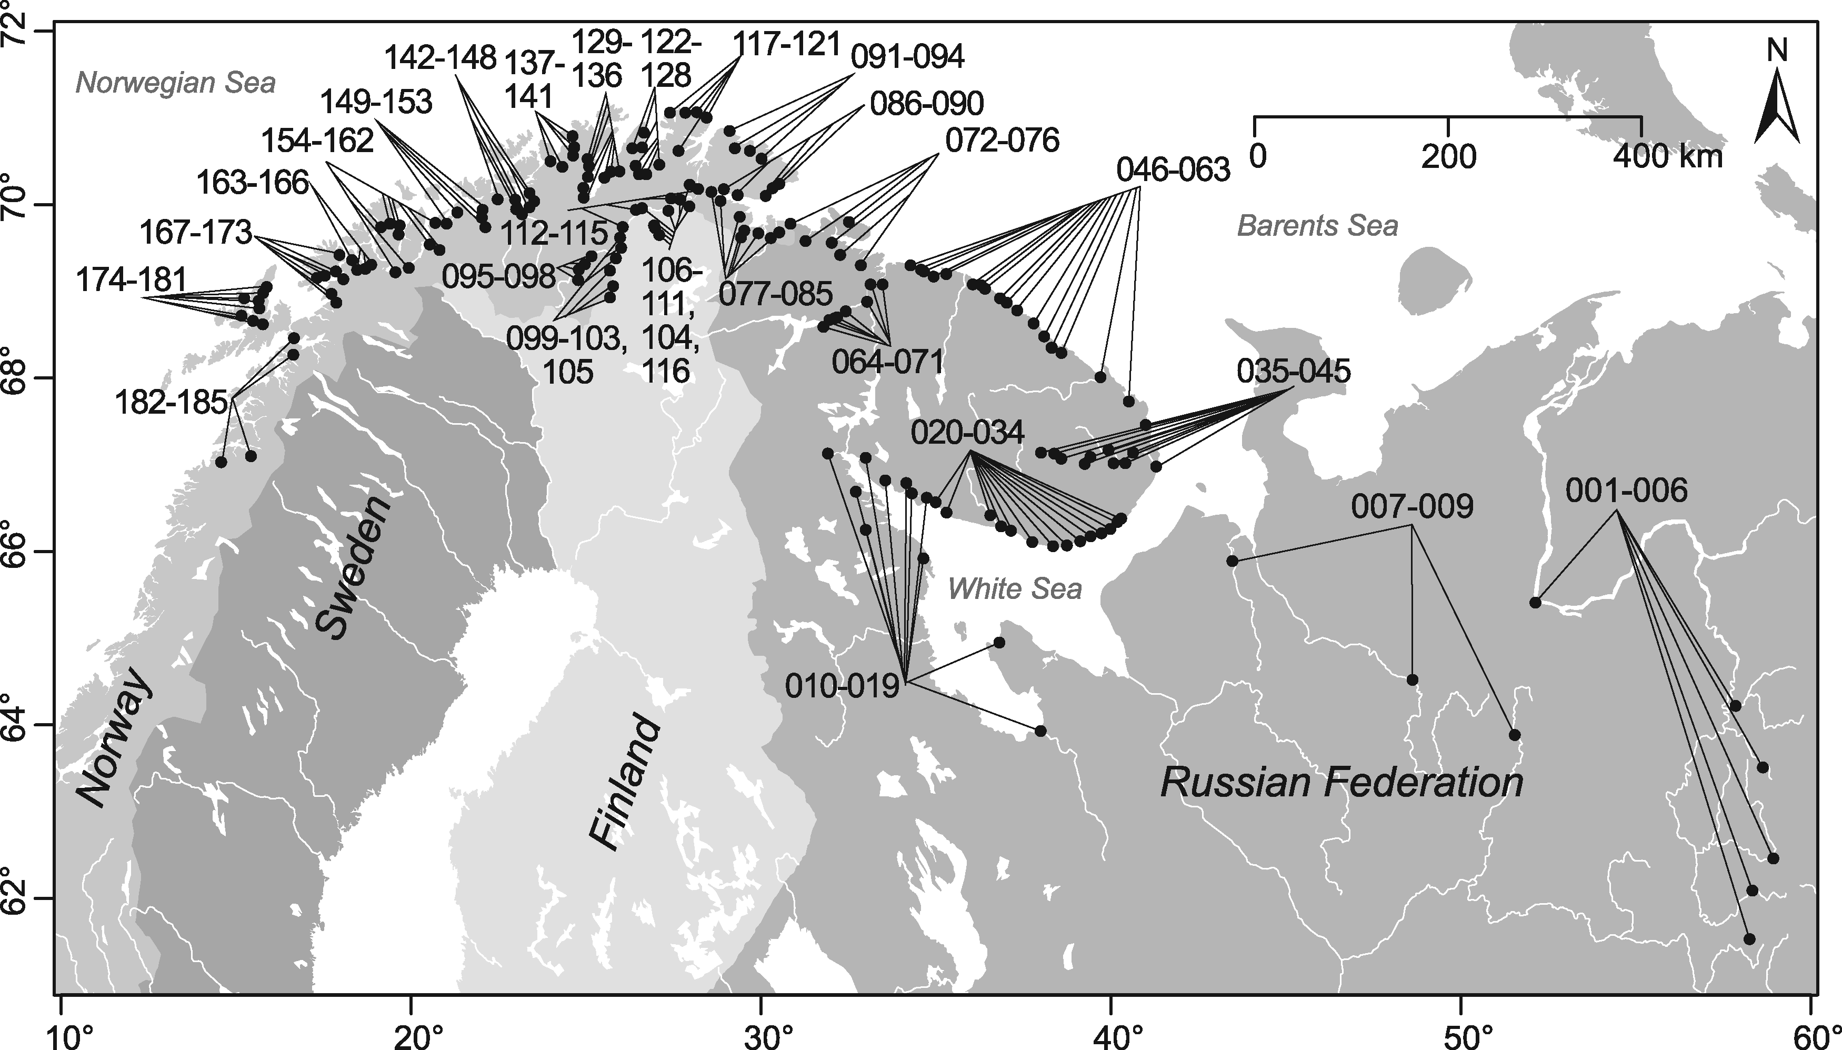
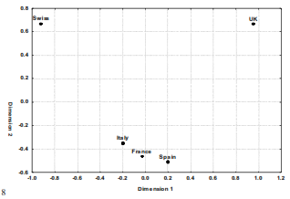
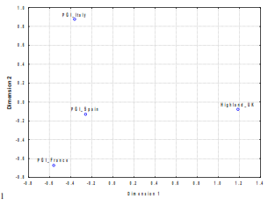
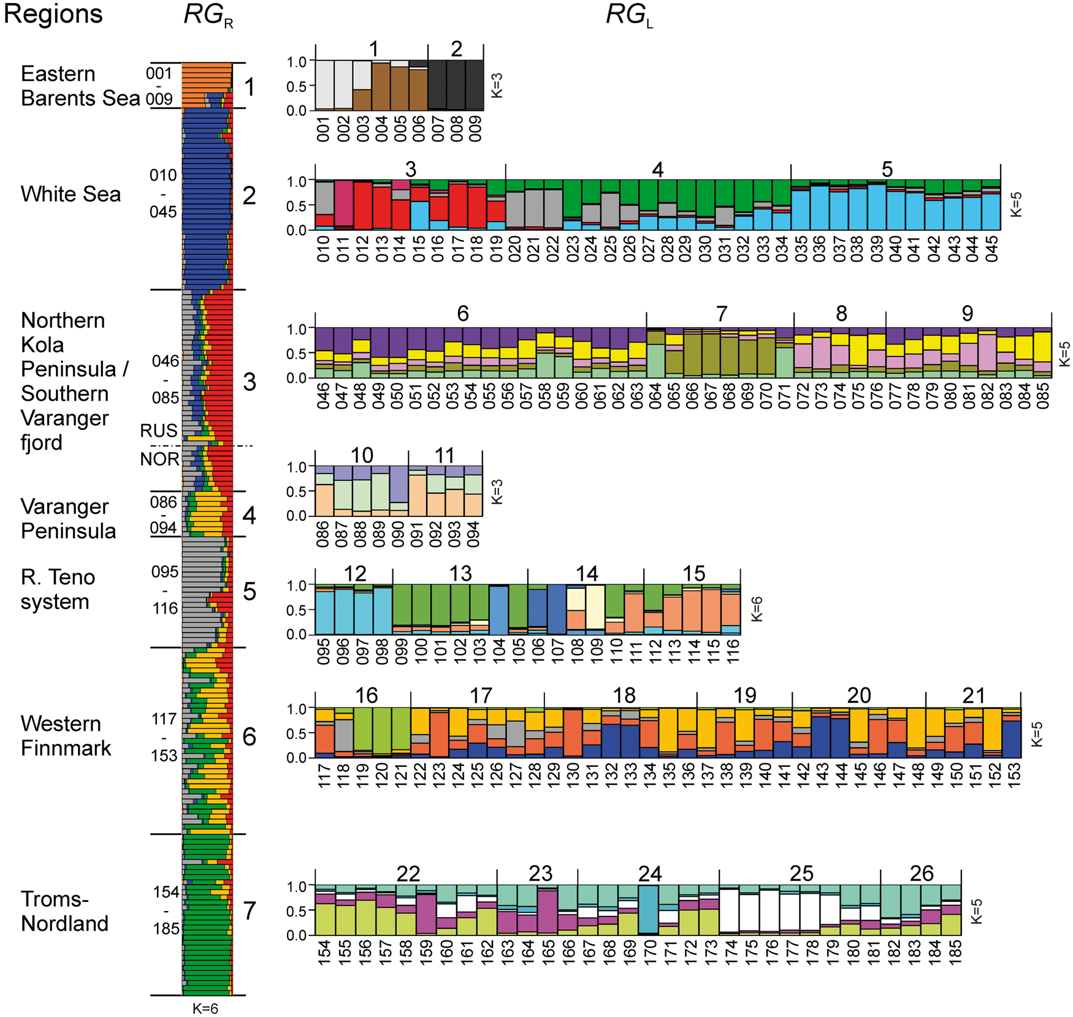
Case Studies
PGI Italy
n = 15,099
Swiss
UK
31 microsatellites
PGI Spain
Highland UK
Italy
France
PGI France
Spain
90 SNPs
24 breeds
n = 1047
Negrini et al 2008
Ozerov et al 2017
Notes:
https://www.sciencedirect.com/science/article/pii/S0308814618317722

Slide 14
Strengths and Limitations
Advantages
Widespread expertise
Individual fingerprint
Universal across different tissues
Commonly utilised
Limitations
No geographic specificity
Method development required
Risk of degradation
Special considerations:
Storage of samples
Proof-of-descent

Slide 15
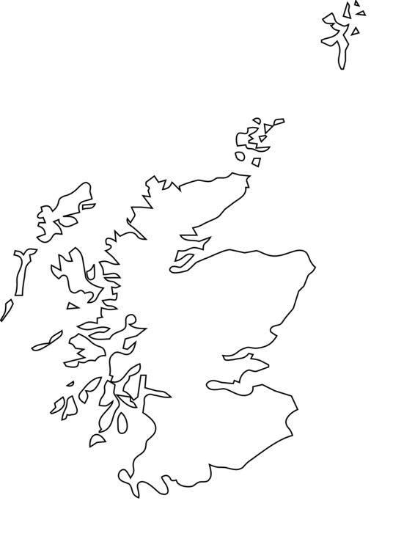
Skills mapping

Slide 16
Stable Isotope analysis

Slide 17
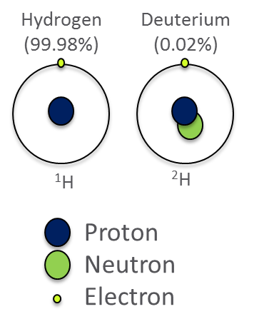
Stable Isotope Ratio Analysis

Slide 18
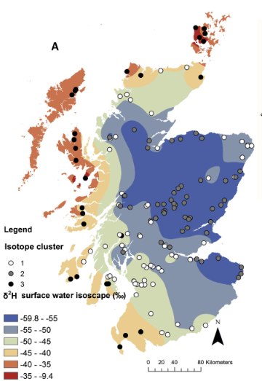
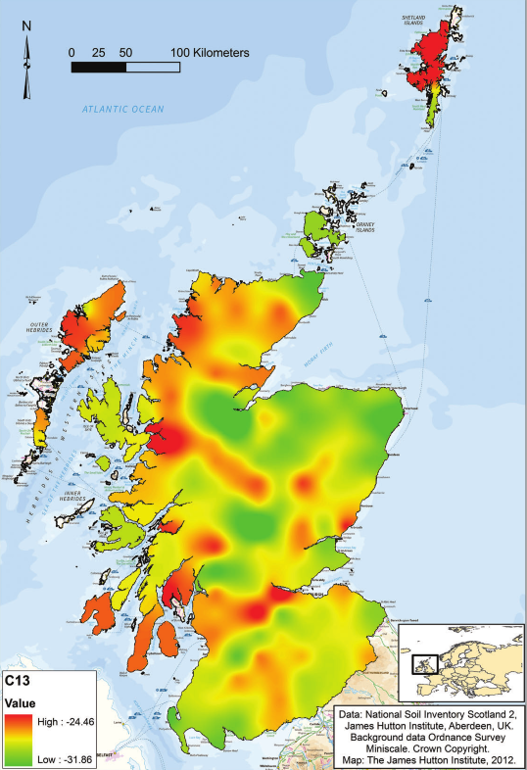
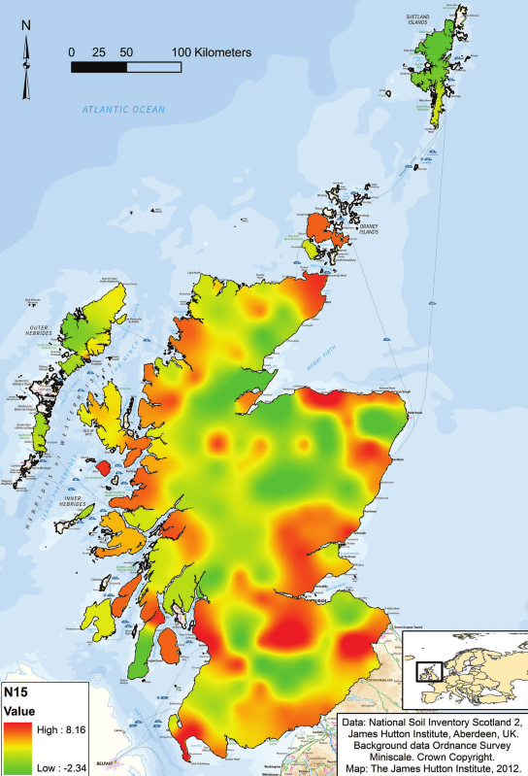
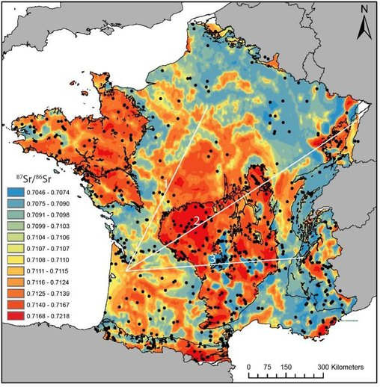
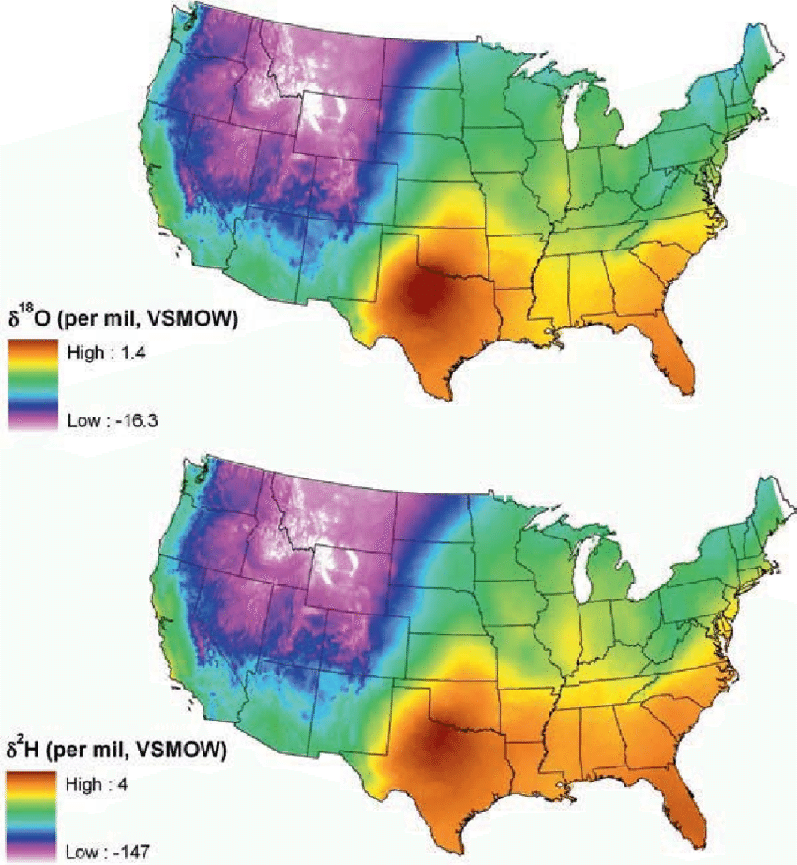
Stable Isotope Ratio Analysis
Hydrogen and Oxygen
Hydrogen
Carbon
Nitrogen
Strontium
Birkel et al 2018 in Journal of Geochemical Exploration
Thornton et al 2015 in European Journal of Soil Science
Thornton et al 2015 in European Journal of Soil Science
Willmes et al 2018 in Applied Geochemistry
Bartelink et al 2016 in Handbook of missing Persons

Slide 19
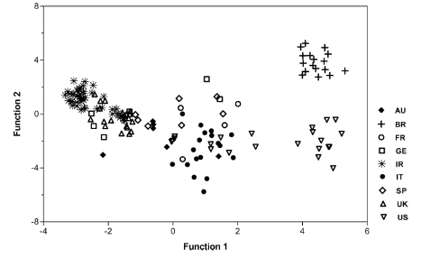
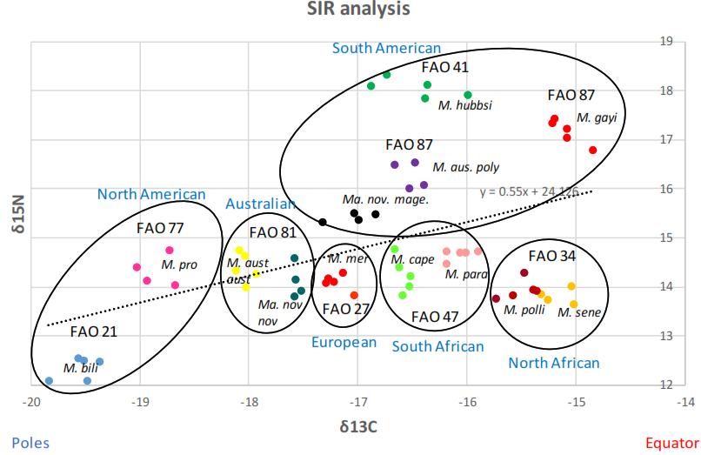
Case Studies
Hake provenance
Bovine muscle provenance
Carrera and Gallardo 2017 in Journal of Agricultural and Food Chemistry
Osorio et al 2011 in Journal of Agricultural and Food Chemistry

Slide 20
Strengths and Limitations
Advantages
Established technology for assessing geographical origin
Multi-element analysis improves accuracy
Limited effects associated with post-harvest
Limitations
Imported feed limits δ¹³C and δ¹⁵N applicability
Marine environment may limit δ²H and δ¹⁸O
Growth in different locations
Required database for isotope ratios
Climate change

Slide 21
Skills mapping

Slide 22
Blockchain Technology

Slide 23
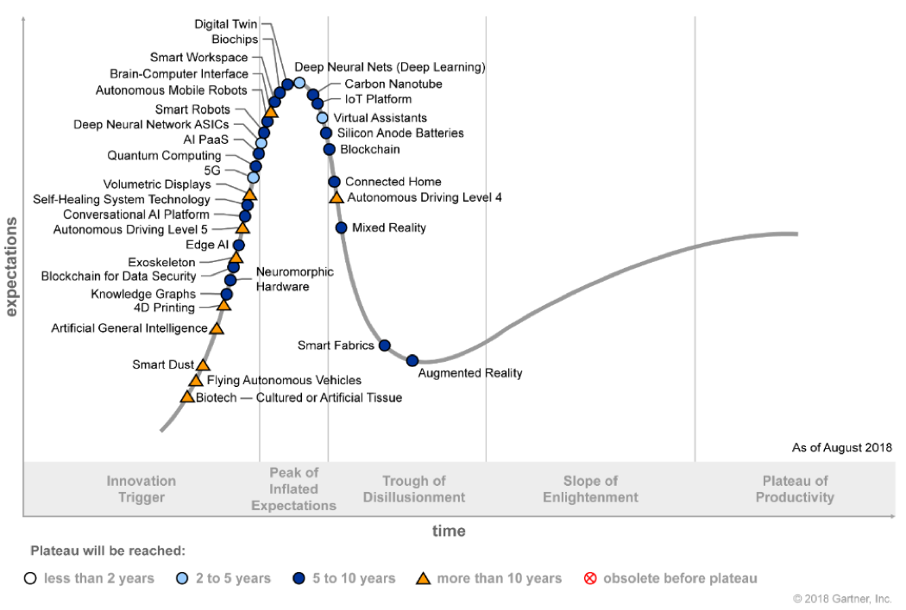
Blockchain Technology

Slide 24
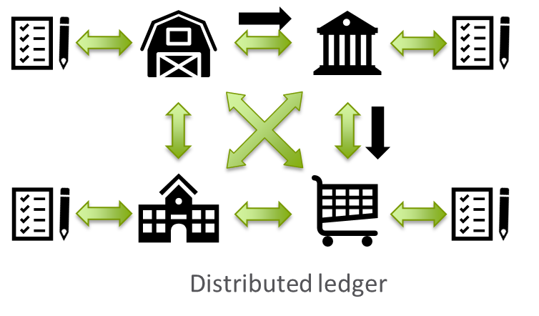
Blockchain Technology
Distributed ledger
Blockchain

Slide 25
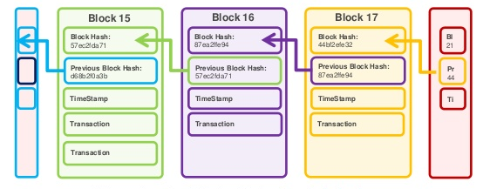
Blockchain Technology
Distributed ledger
Blockchain
https://www.slideshare.net/AmazonWebServices/exploring-blockchain-technology-risks-and-emerging-trends-arc313-reinvent-2017

Slide 26
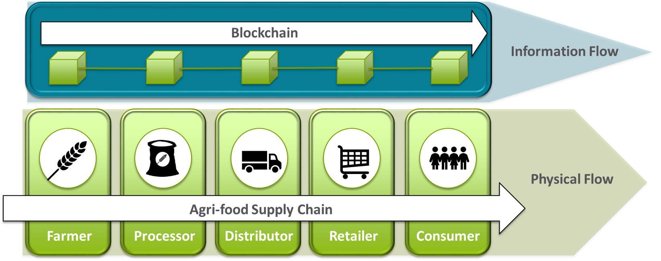
Blockchain technology

Slide 27
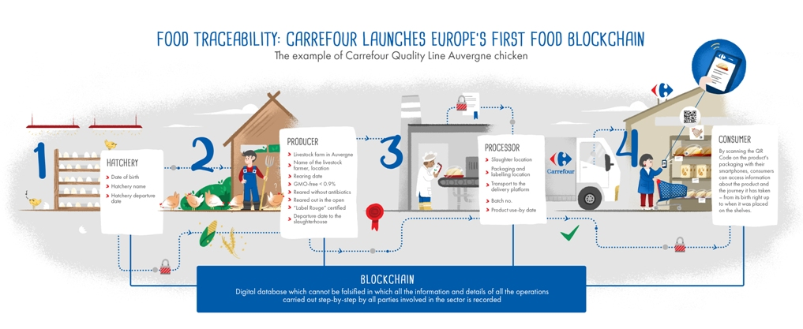
Case studies

Slide 28
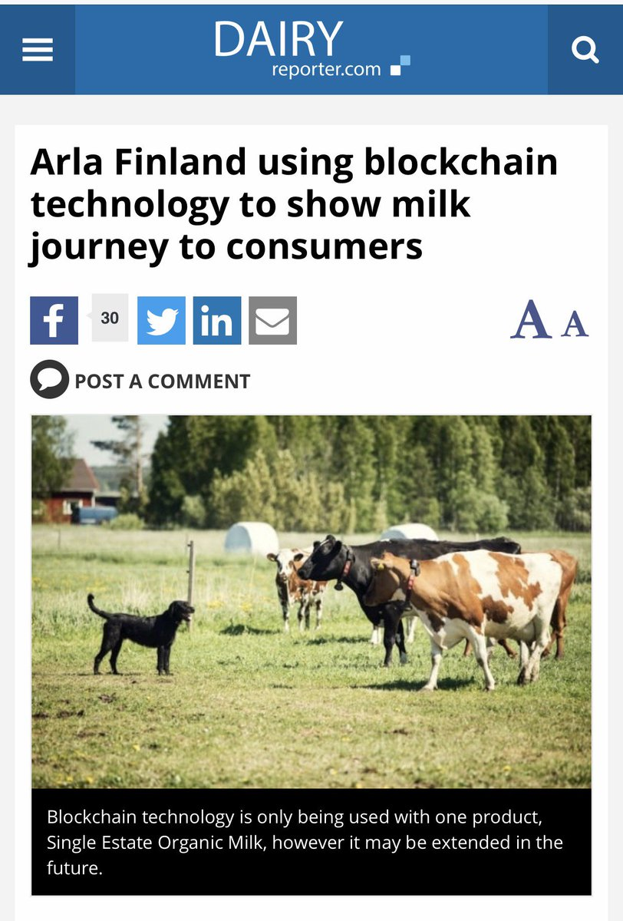
Case studies

Slide 29
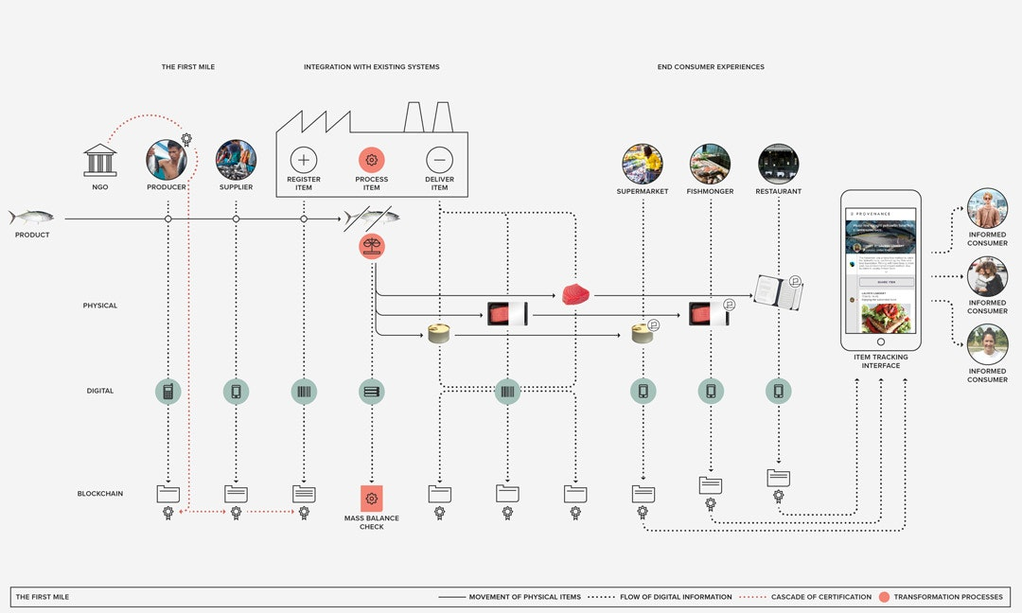
Provenance.org

Slide 30
Strengths and Limitations
Advantages
Transparency
Tamper-proof
Cost-efficiency
Integration with current tools
Promotes Trust
Limitations
Linkage with physical flows
Platform choice
Computing power
Early-development
High-trust supply chains

Slide 31
Skills mapping

Slide 32
Radio Frequency IDs (RFIDs)

Slide 33
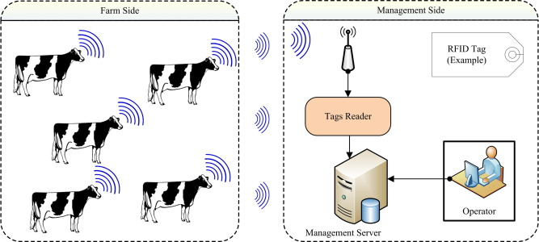
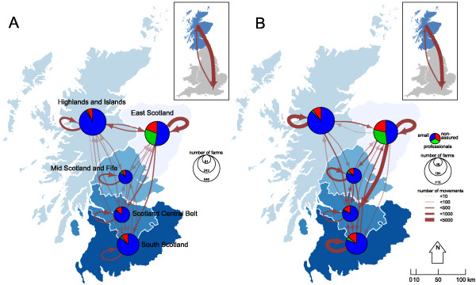
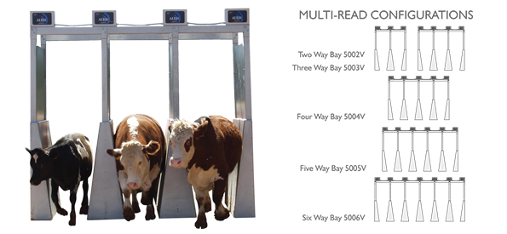
RFIDs and EIDs
Awad 2016 in Computers and Electronics in Agriculture
Porphyre et al 2014 in BMC Veterinary Research
http://www.aleis.com/industrial/multi-read-systems-5002V-5006V/multi-read-systems-5002v-5006v

Slide 34
Strengths and Limitations
Advantages
Link between EIDs and animals
Ease of use
Already established
Limitations
Limited information
Not Farm-to-Fork
Not intrinsic to the product

Slide 35
Integrated solutions

Slide 36
Technologies
Authenticity
Provenance
Traceability
Genetic markers
Isotope ratio
BCT, RFIDs and EIDs

Slide 37
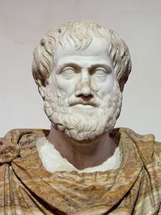
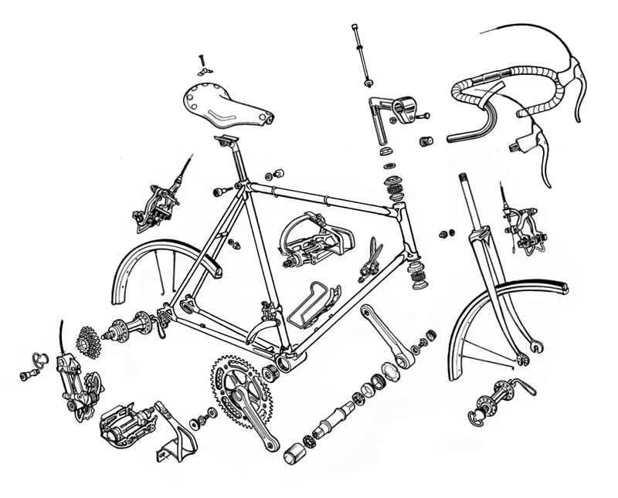
“The whole is greater than the sum of its parts.”
― Aristotle

Slide 38
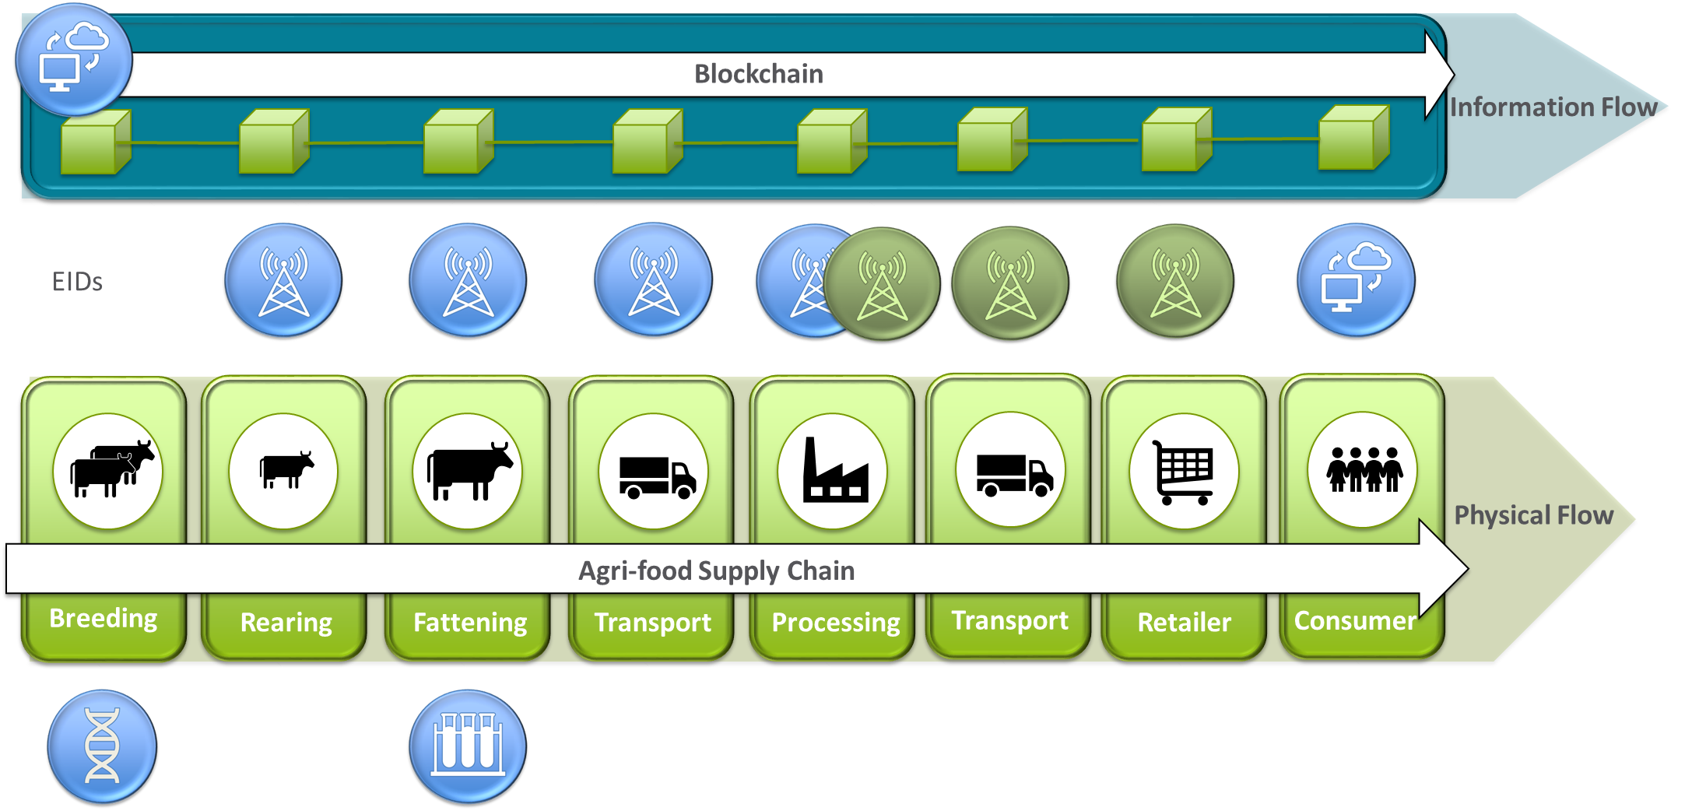

Slide 39
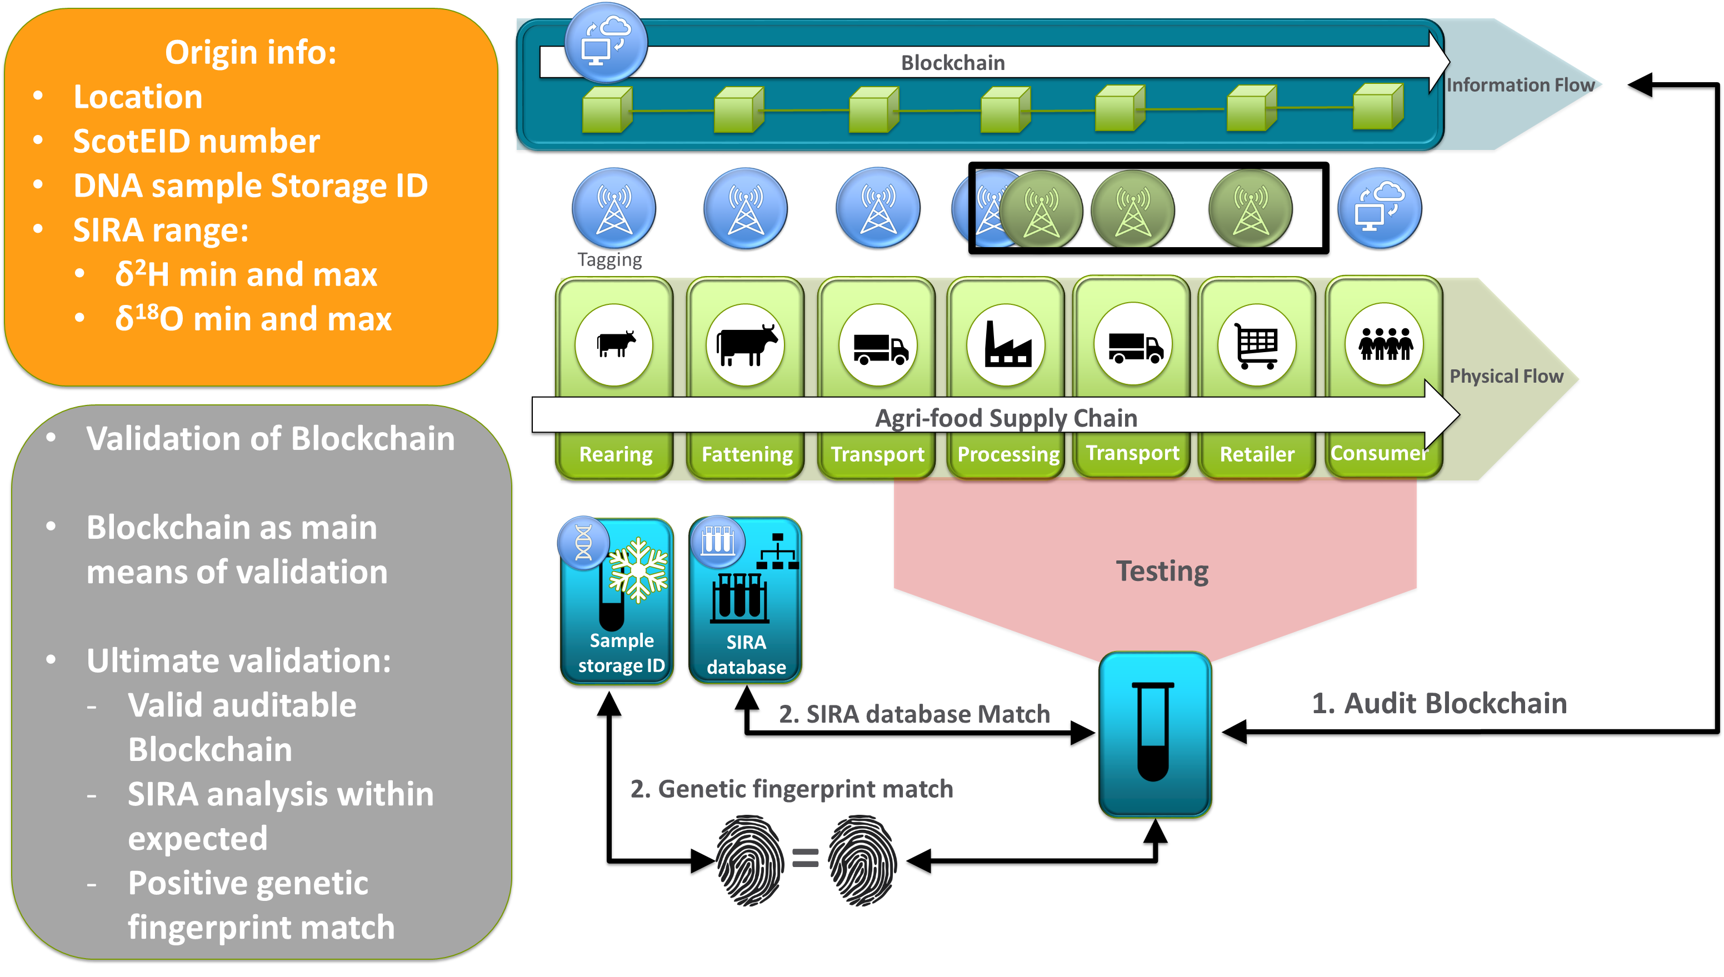

Slide 40
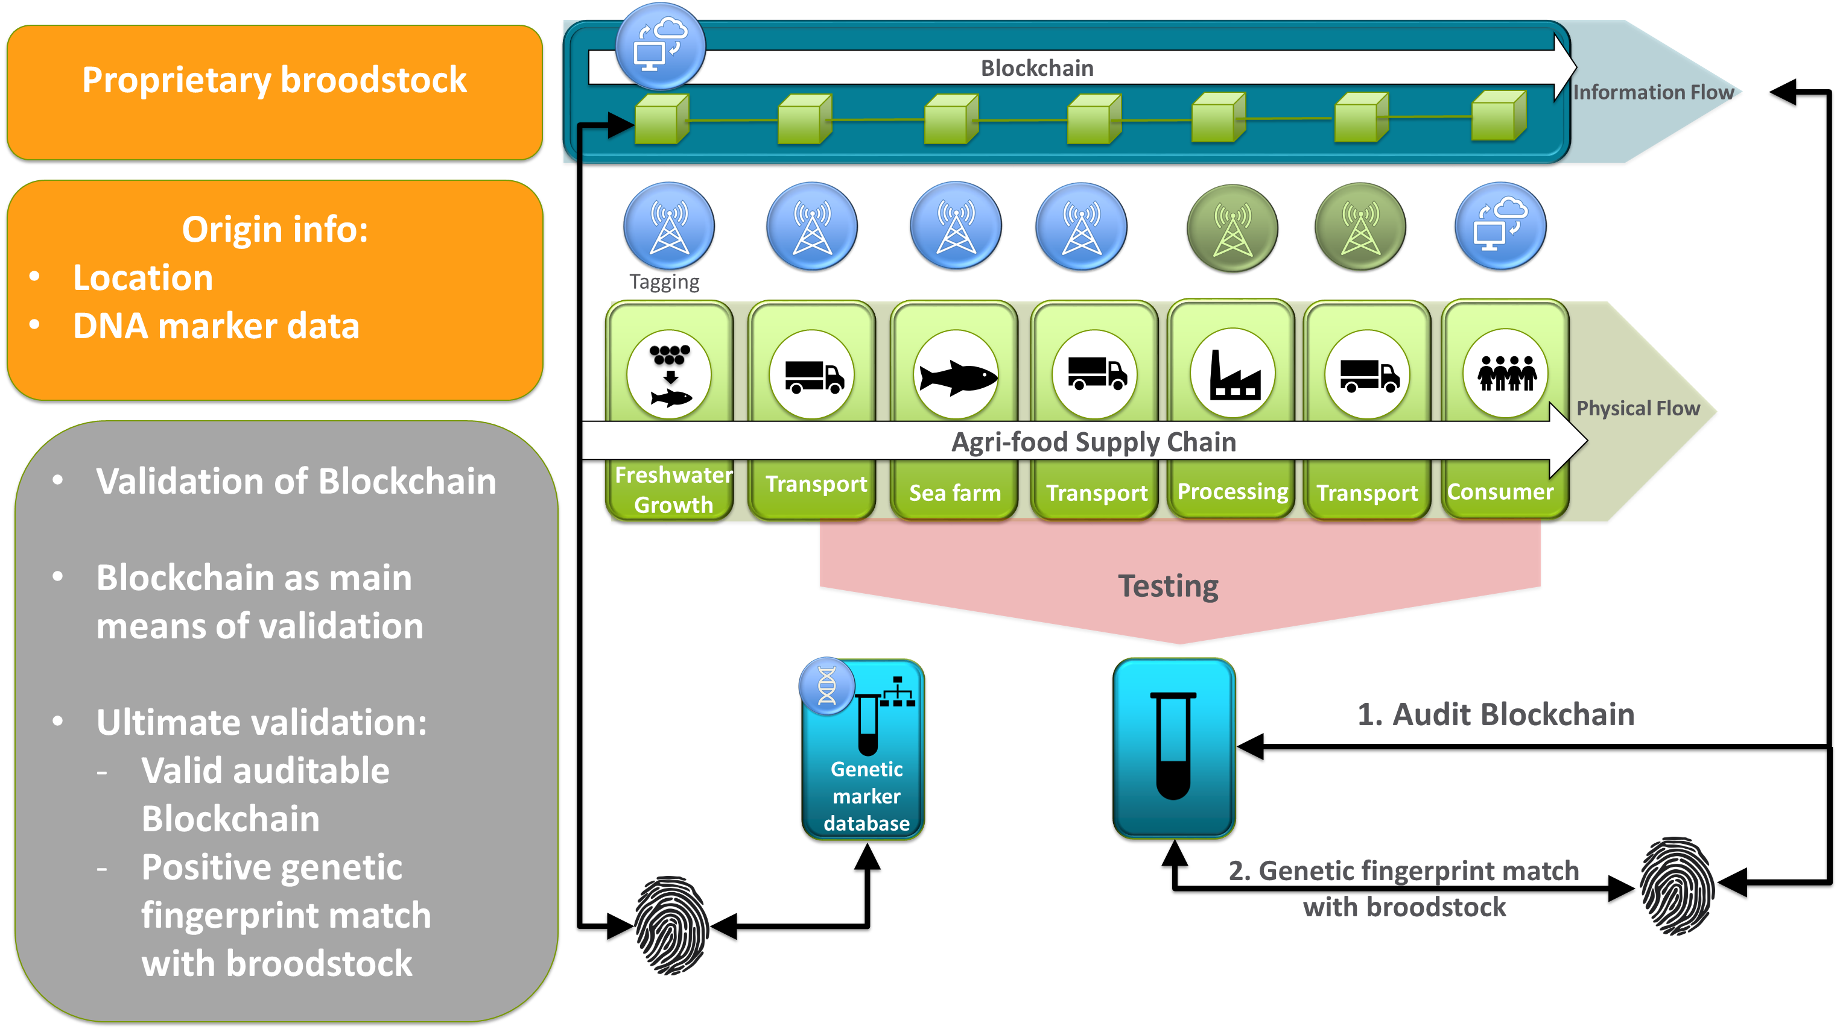

Slide 41
Future
Scottish Salmon traceability demonstration project
Beef traceability demonstration project
Alternative project
Further research/observation
Greater scope
Development of Networks

Slide 42
Thank you
Alex.Foito@Hutton.ac.uk
sefari.scot
info@sefari.scot
@SEFARIscot

